Slide 1
Image Morphing with the Beier-Neely Algorithm
Mohammed Modan
Travis Beach

Slide 2
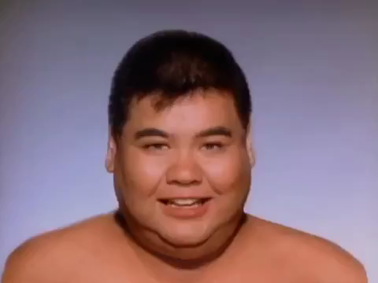
Idea: Transition between two images
Michael Jackson’s Black or White

Slide 3


Simple Method
Crossfading
An image is a bunch of <r, g, b> vectors for each pixel
i.e. <255,0,0>,<0,255,0> gives a 2x1 image, blue and green pixel
ImageA + t(ImageB – ImageA)

Slide 4
Beier-Neely Algorithm (1992)
Transform based on source and destination vectors
Michael Jackson’s video
Us. Implemented in Wolfram Mathematica

Slide 5
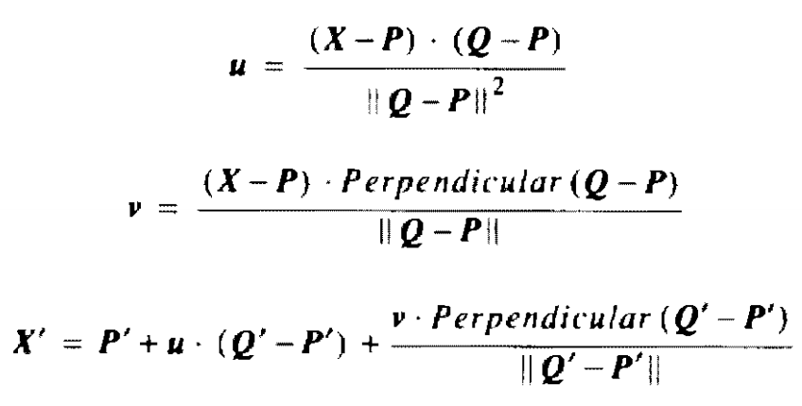
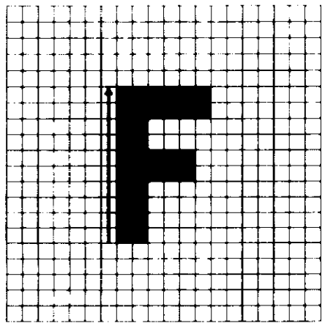
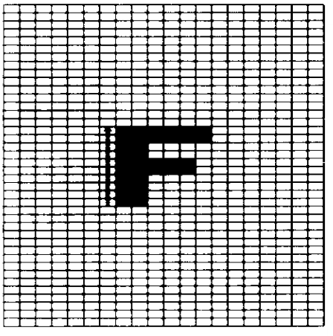
The Math

Slide 6
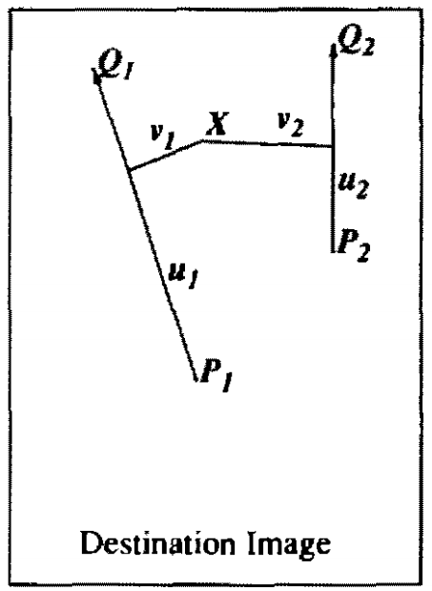
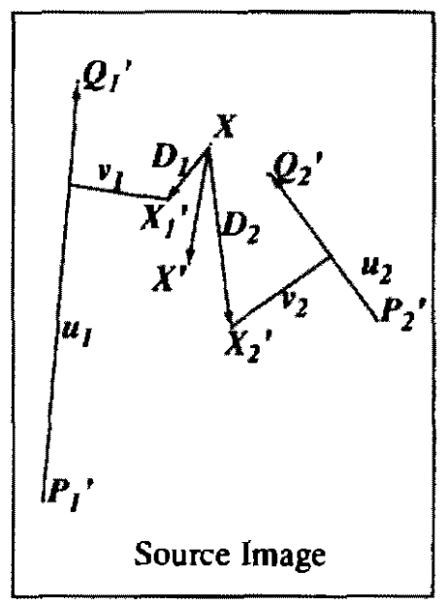
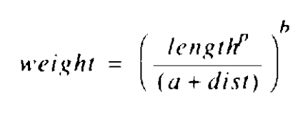
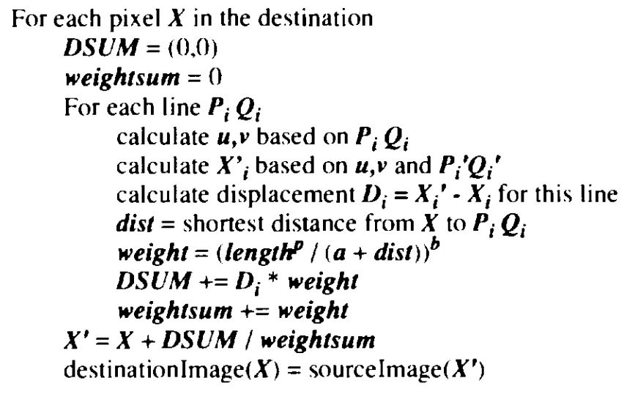
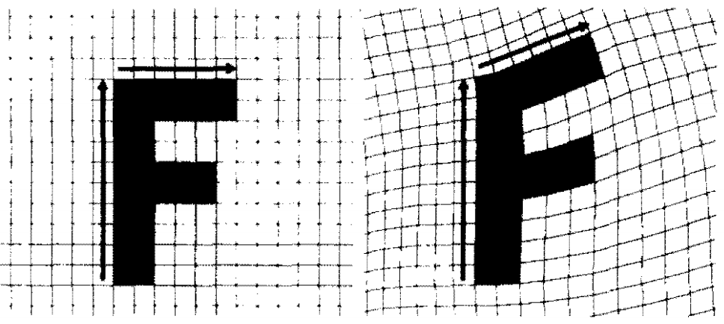
Multiple Lines
source
Source Image
Destination Image
X
Q
dist
dist
X
P
dist
X

Slide 7
A Moving Morph
Q’
Q’
Q’
Q’
Q’
Q
Q
Frame 6
Frame 6
Frame 5
Frame 5
Frame 4
Frame 4
Frame 3
Image B
Frame 3
Image A
Frame 2
Frame 2
Frame 1
Frame 1
Frame 0
Frame 0
P
P’
P’
P’
P’
P’
P
t = 0
t = 1/6
t = 1/3
t = 1/2
t = 2/3
t = 5/6
t = 1
Need to parameterize

Slide 8
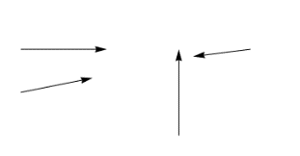
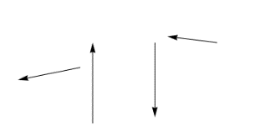
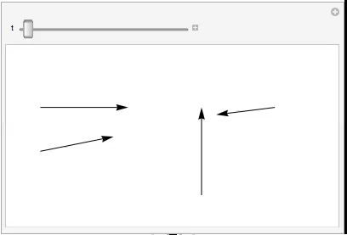
How to Parameterize?
2
4
4
1
1
3
3
2
Parameterize P and Q
Parameterize vector midpoint, angle, length

Slide 9
Midpoint, Angle, Length
Normal parameterization doesn’t work: θ[t]’ = θ_{A} + t(θ_{B} – θ_{A})
π/2
π
0
-π
-π/2

Slide 10
Midpoint, Angle, Length
Normal parameterization doesn’t work: θ[t]’ = θ_{A} + t(θ_{B} – θ_{A})
π/2
π
0
-π
-π/2

Slide 11
Midpoint, Angle, Length
Normal parameterization doesn’t work: θ[t]’ = θ_{A} + t(θ_{B} – θ_{A})
π/2
π
0
-π
-π/2

Slide 12
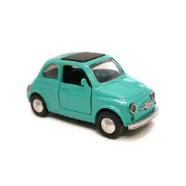
Midpoint, Angle, Length
Normal parameterization doesn’t work: θ[t]’ = θ_{A} + t(θ_{B} – θ_{A})
π/2
π
0
-π
-π/2

Slide 13
Midpoint, Angle, Length
Normal parameterization doesn’t work: θ[t]’ = θ_{A} + t(θ_{B} – θ_{A})
If |θ_{A}| ≤ π/2 && |θ_{B}| ≤ π/2
Then: θ[t]’ = θ_{A} + t(θ_{B} – θ_{A})
π/2
π
0
-π
-π/2

Slide 14
Midpoint, Angle, Length
Normal parameterization doesn’t work: θ[t]’ = θ_{A} + t(θ_{B} – θ_{A})
If |θ_{A}| ≤ π/2 && |θ_{B}| ≤ π/2
Then: θ[t]’ = θ_{A} + t(θ_{B} – θ_{A})
Else:
If sign(θ_{A}) == sign(θ_{B})
Then: θ[t]’ = θ_{A} + t(θ_{B} – θ_{A})
π/2
π
0
-π
-π/2

Slide 15
Midpoint, Angle, Length
Normal parameterization doesn’t work: θ[t]’ = θ_{A} + t(θ_{B} – θ_{A})
If |θ_{A}| ≤ π/2 && |θ_{B}| ≤ π/2
Then: θ[t]’ = θ_{A} + t(θ_{B} – θ_{A})
Else:
If sign(θ_{A}) == sign(θ_{B})
Then: θ[t]’ = θ_{A} + t(θ_{B} – θ_{A})
Else:
If θ_{A} > θ_{B}
Then: θ[t]’ = θ_{A} + t((θ_{B} + 2π) – θ_{A})
π/2
π
0
2π
3π/2

Slide 16
Midpoint, Angle, Length
Normal parameterization doesn’t work: θ[t]’ = θ_{A} + t(θ_{B} – θ_{A})
If |θ_{A}| ≤ π/2 && |θ_{B}| ≤ π/2
Then: θ[t]’ = θ_{A} + t(θ_{B} – θ_{A})
Else:
If sign(θ_{A}) == sign(θ_{B})
Then: θ[t]’ = θ_{A} + t(θ_{B} – θ_{A})
Else:
If θ_{A} > θ_{B}
Then: θ[t]’ = θ_{A} + t((θ_{B} + 2π) – θ_{A})
Else: θ[t]’ = (θ_{A} + 2π) + t(θ_{B} – (θ_{A} + 2π))
π/2
π
0
2π
3π/2

Slide 17
Rebuild P & Q
P[t]’ = Midpoint[t]’ – <Length[t]/2’*cos(θ[t]’), Length[t]/2*sin(θ[t]’)>
Q[t]’ = Midpoint[t]’ + <Length[t]/2’*cos(θ[t]’), Length[t]/2*sin(θ[t]’)>
X
Y
Q’
Length[t]’
Midpoint[t]’
Y
θ[t]’
P’
X

Slide 18
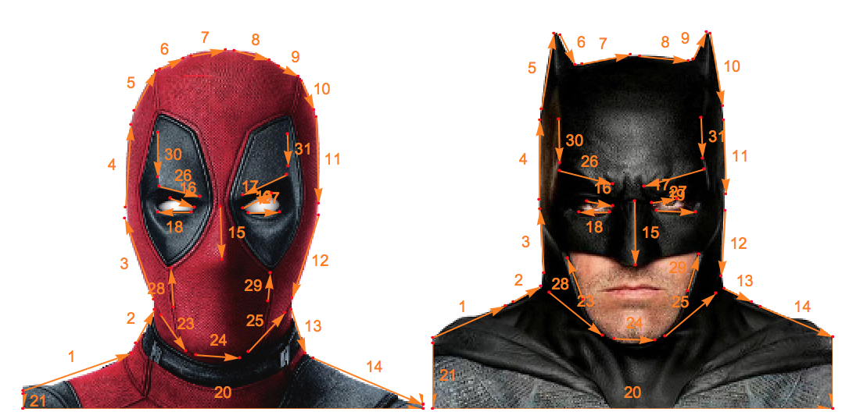
Putting it together
Image one, vectors A
Image two, vectors B

Slide 19
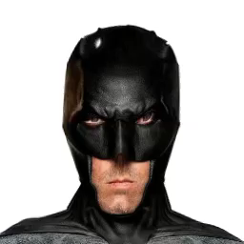
Putting it together
Image | One
Morph from | A
Morph to | A -> B
Image | Two
Morph from | B
Morph to | A -> B

Slide 20
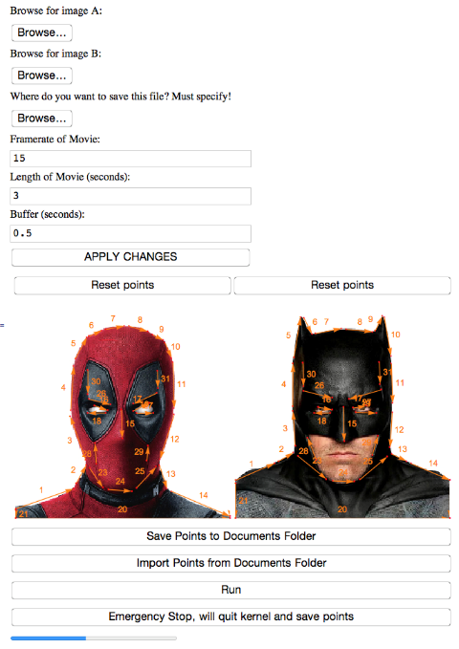

Slide 21
Coefficients
a = 0.2, b = 1, p = 0.5
a = 0.001, b = 2, p = 0

Slide 22
Results

Slide 23

Results

Slide 24
Results

Slide 25
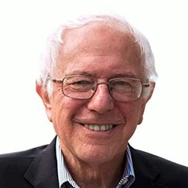
Results

Slide 26
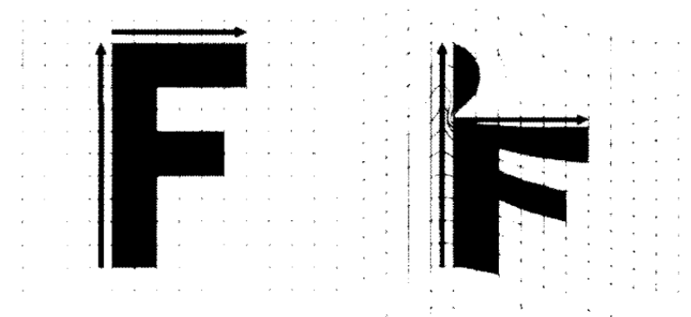
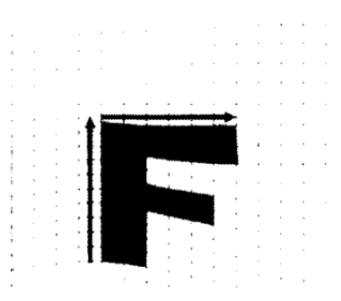
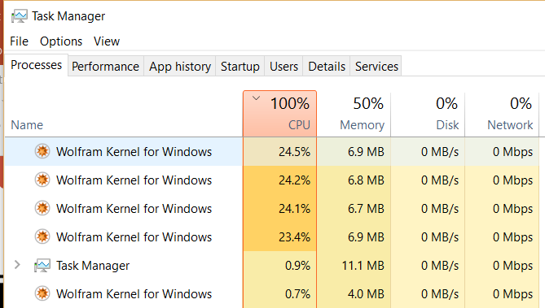
Issues/Limitations
Ghosts
Parallelizing on virtual cores
Render time
256x256 images: 3-4h. 512x512 images: projected at 36h
Mostly limit of our implementation

Slide 27
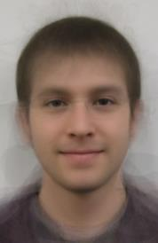
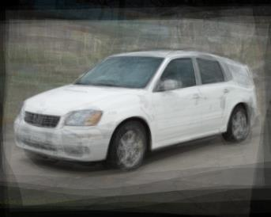
Future
Probably better with the GPU
Add the ability to recomposite morph on the old background
Image averaging?
Average all midpoints/angles/lengths of vectors from n images
Morph each image to the average vector set, cross-dissolve all of them

