Slide 1

Teaching a Computer to Predict Heart Disease with Geometry
Mohammed Modan
mmodan@macalester.edu

Slide 2

How do Support Vector Machines (SVMs) work?
Input
Input
Output
Predicted Output

Slide 3
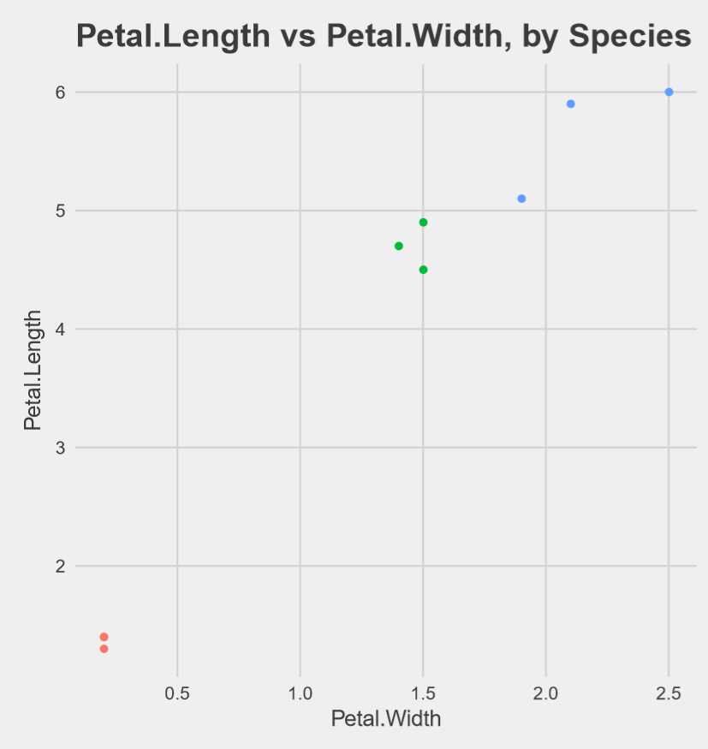
What does training data look like? (basic example)
Petal.Length | Petal.Width
1.4 | 0.2
1.4 | 0.2
1.3 | 0.2
4.7 | 1.4
4.5 | 1.5
4.9 | 1.5
6 | 2.5
5.1 | 1.9
5.9 | 2.1
Species | Species 1
 | Species 2
 | Species 3
ℝ²

Slide 4
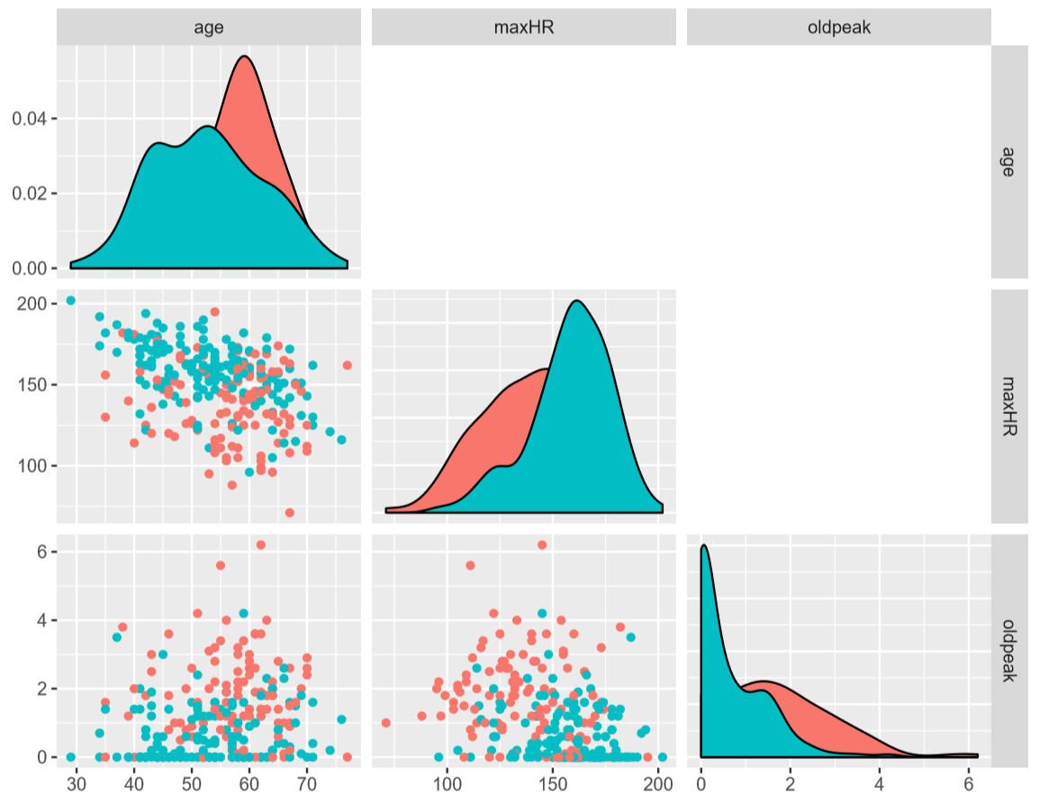
What about real data?
age | maxHR | oldpeak
64 | 105 | 0.2
74 | 121 | 0.2
65 | 140 | 0.4
… | … | …
56 | 142 | 0.6
60 | 170 | 1.2
63 | 154 | 4.0
… | … | …
Heart Disease? | Negative
 | Positive
ℝ³

Slide 5
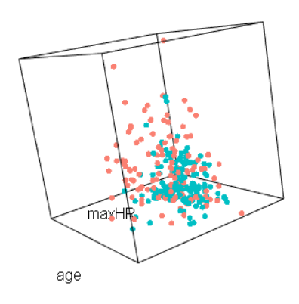
What about real data?

Slide 6
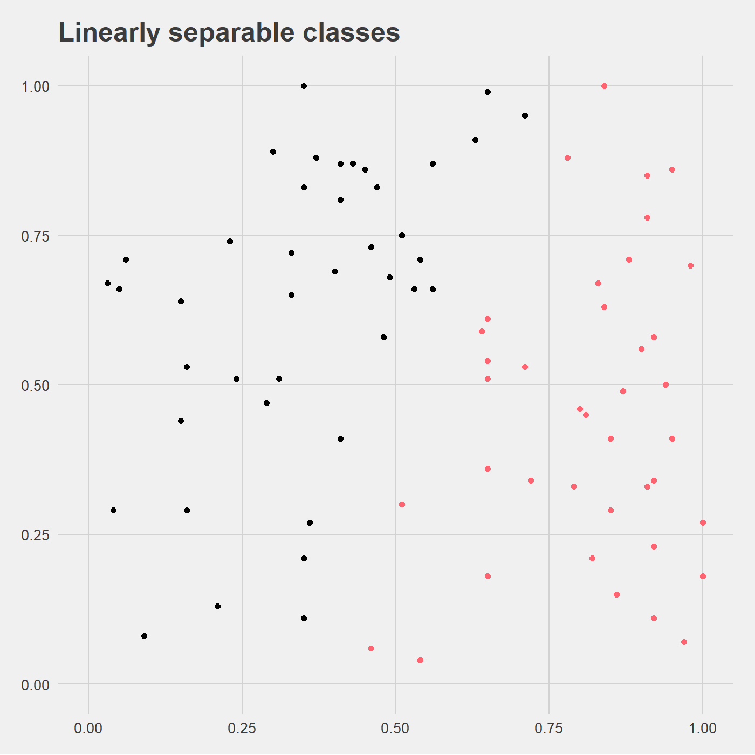
How does the SVM work?
Maximum margin hyperplane, halfway in margin
● Positive
● Negative
maxHR
Maximum margin
age

Slide 7
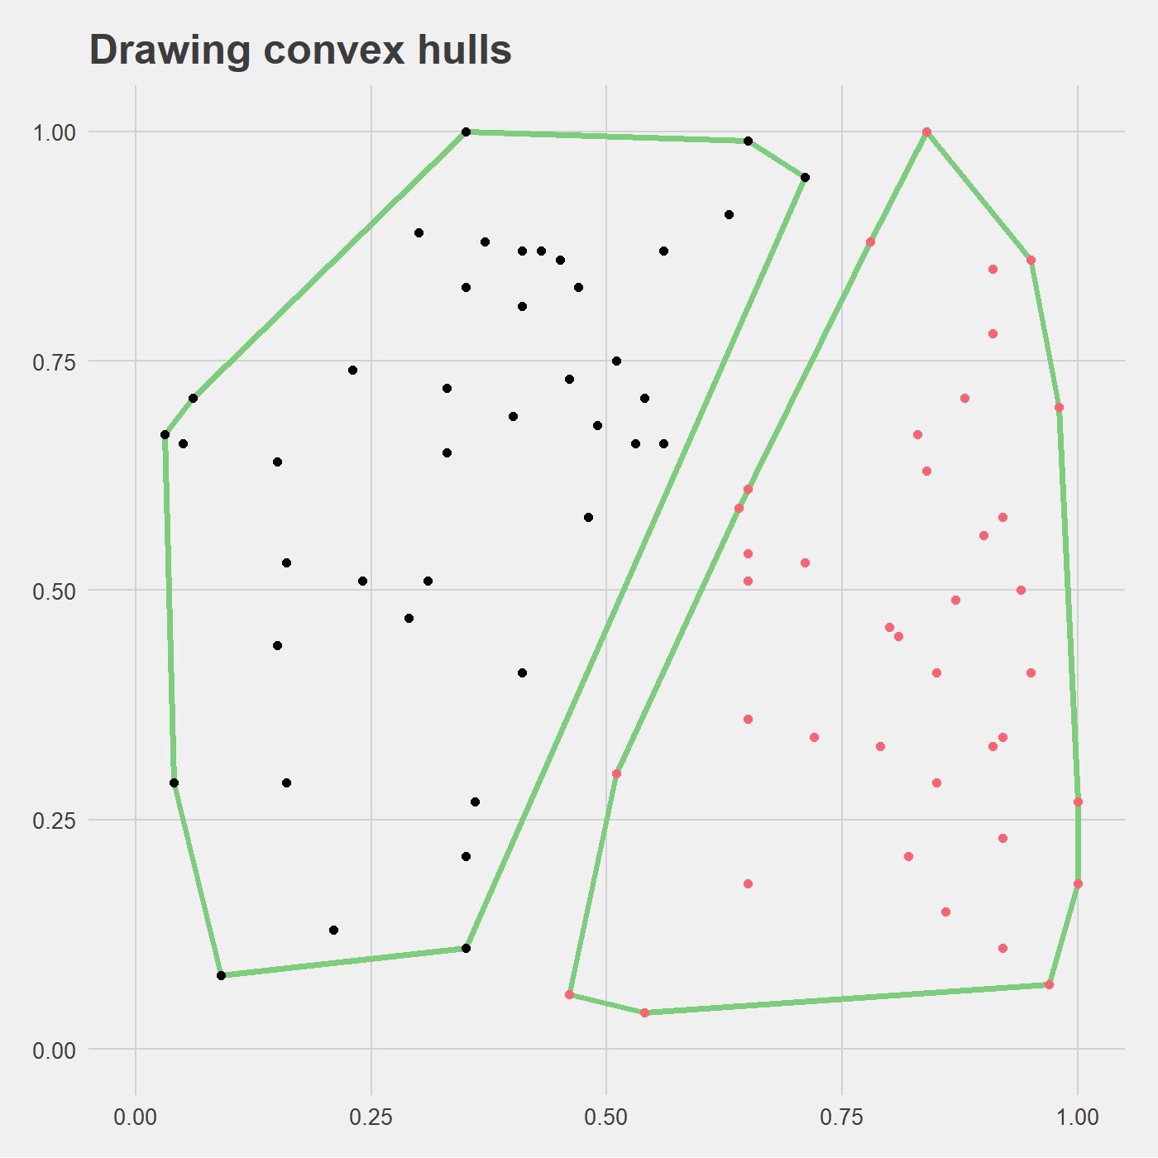
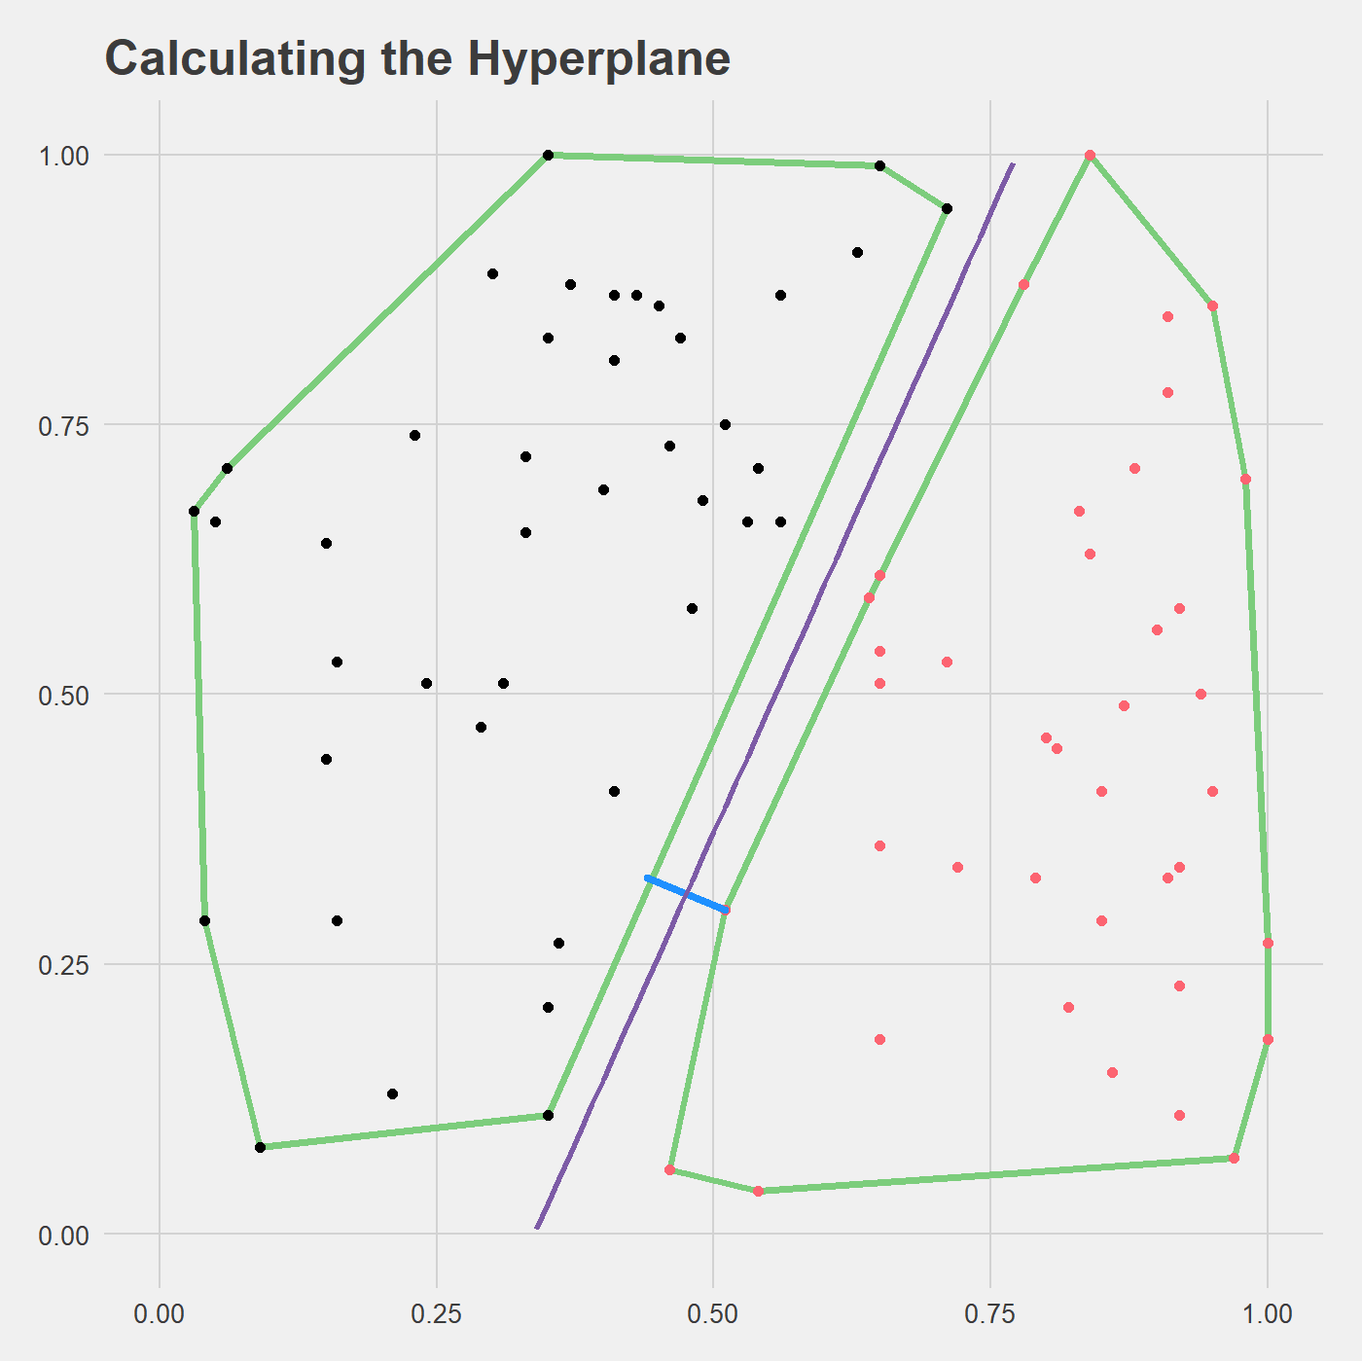



Nearest Point Problem
$$w⋅x+b<0$$
$$w⋅x+b=0$$
$$w⋅x+b>0$$
w
Hyperplane is the perpendicular bisector of w

Slide 8
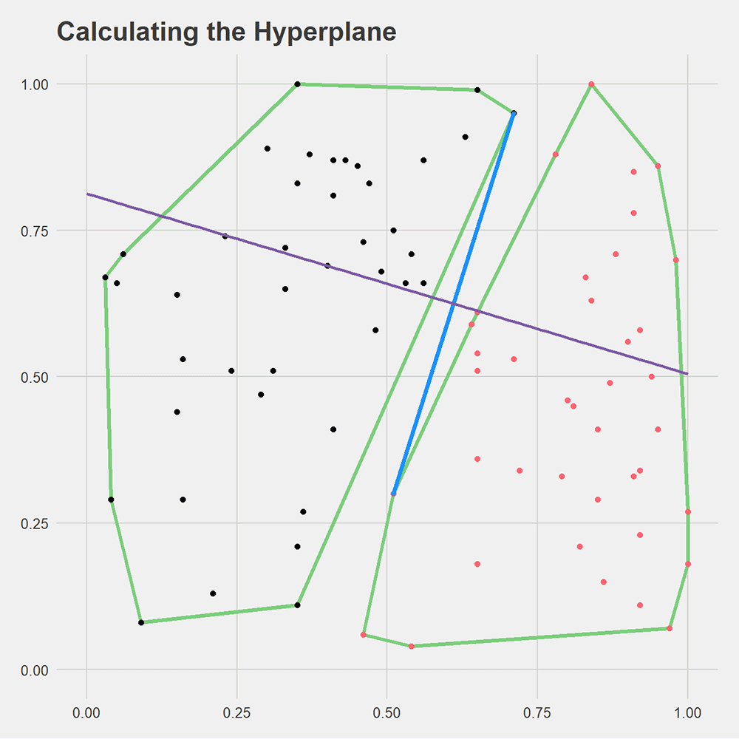
An iterative algorithm
How can we find the nearest points?
Solve a complex optimization problem
Find it iterably in an intuitive way

Slide 9
Schlesinger-Kozinec Algorithm
n
neg
pos

Slide 10
Schlesinger-Kozinec Algorithm
n
neg
p_{pos}
pos

Slide 11
Schlesinger-Kozinec Algorithm
p_{neg}
w
neg
p_{pos}
pos

Slide 12
Schlesinger-Kozinec Algorithm
v_{pos}
p_{neg}
w
neg
p_{pos}
pos

Slide 13
Schlesinger-Kozinec Algorithm
v_{pos}
v_{pos} - p_{pos}
p_{neg}
w*
p_{pos}*
w
neg
p_{pos}
pos

Slide 14
Schlesinger-Kozinec Algorithm
v_{pos}
p_{neg}
w
p_{pos}
neg
pos

Slide 15
Let’s see it in action!

Slide 16
Let’s see it in action!

Slide 17
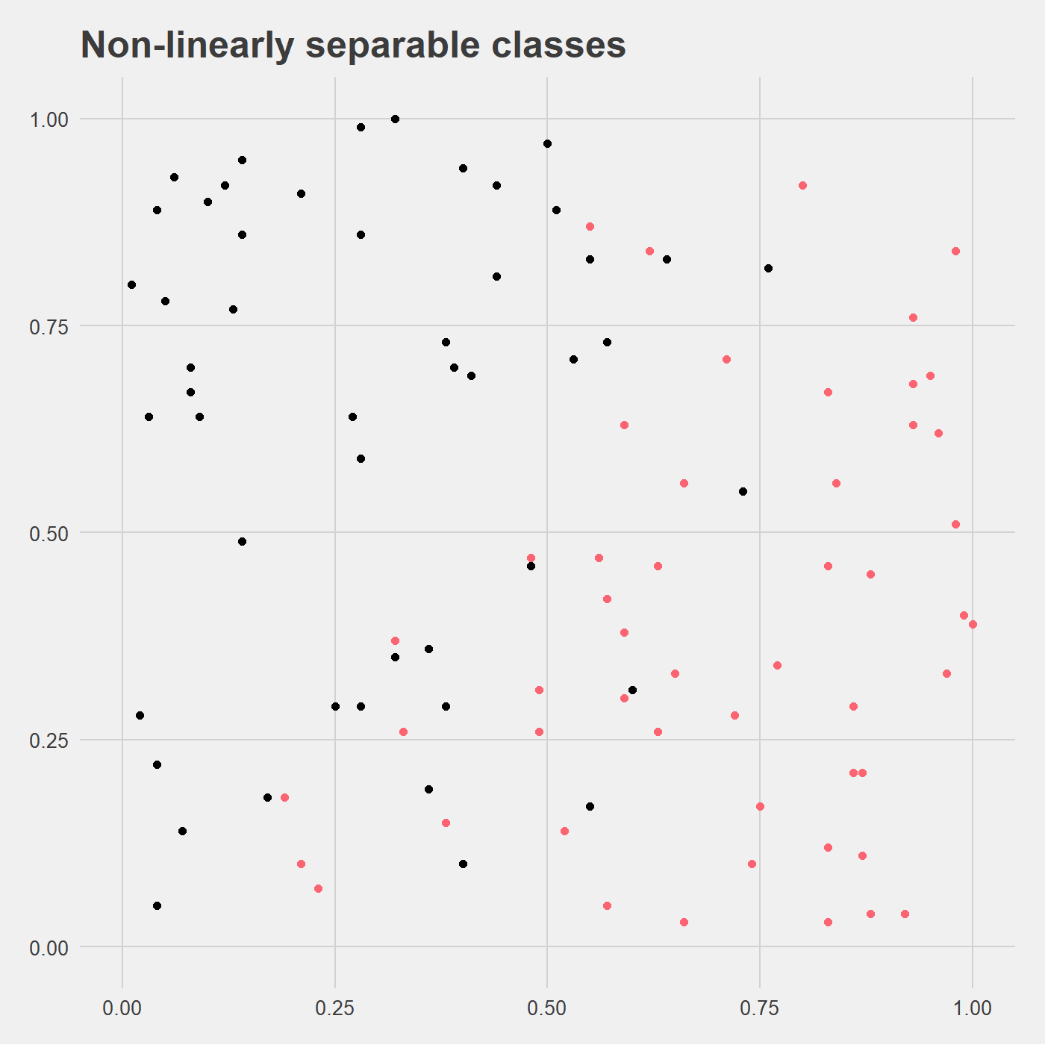
So that was the linearly separable case…

Slide 18
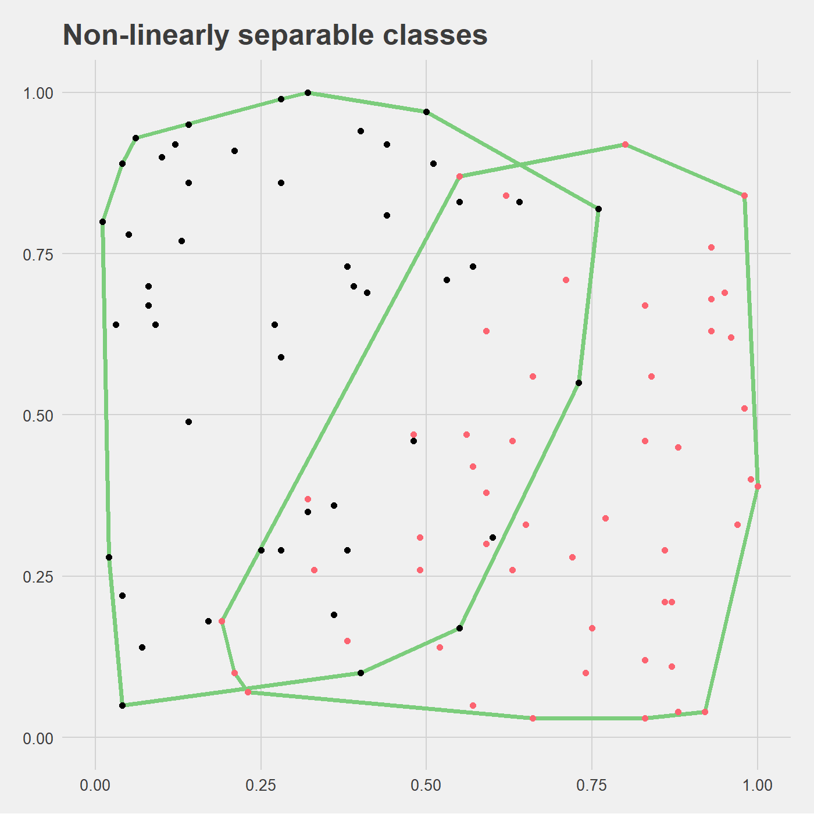
So that was the linearly separable case…

Slide 19
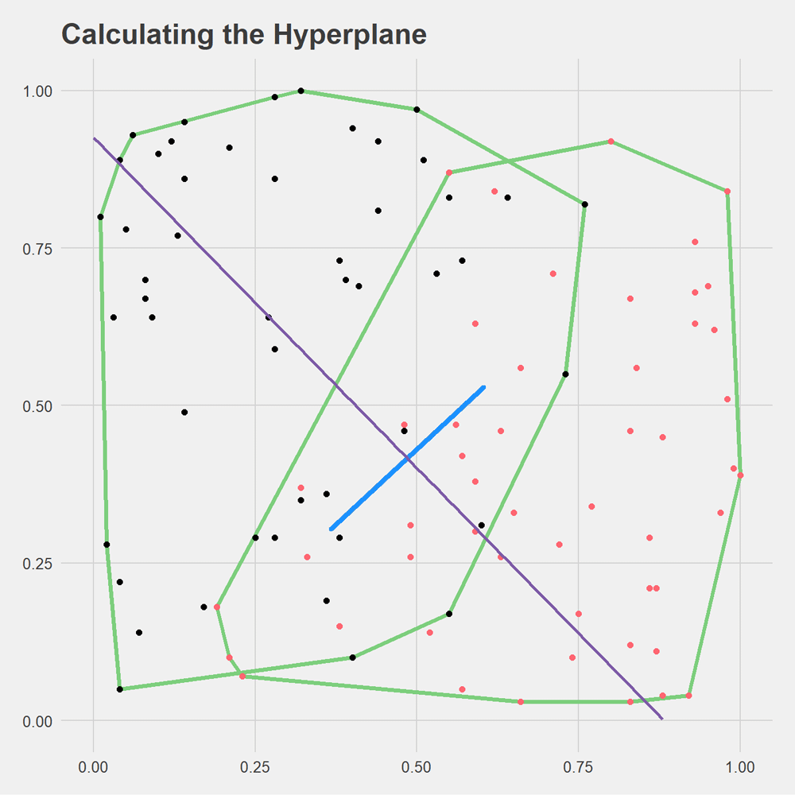
Just try it, maybe it’ll work?

Slide 20
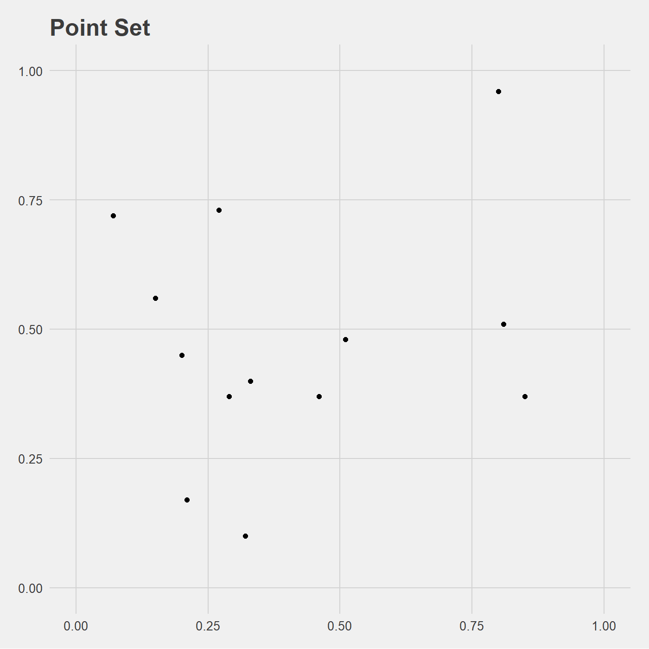
Convex Hull Reduction (RCH)

Slide 21
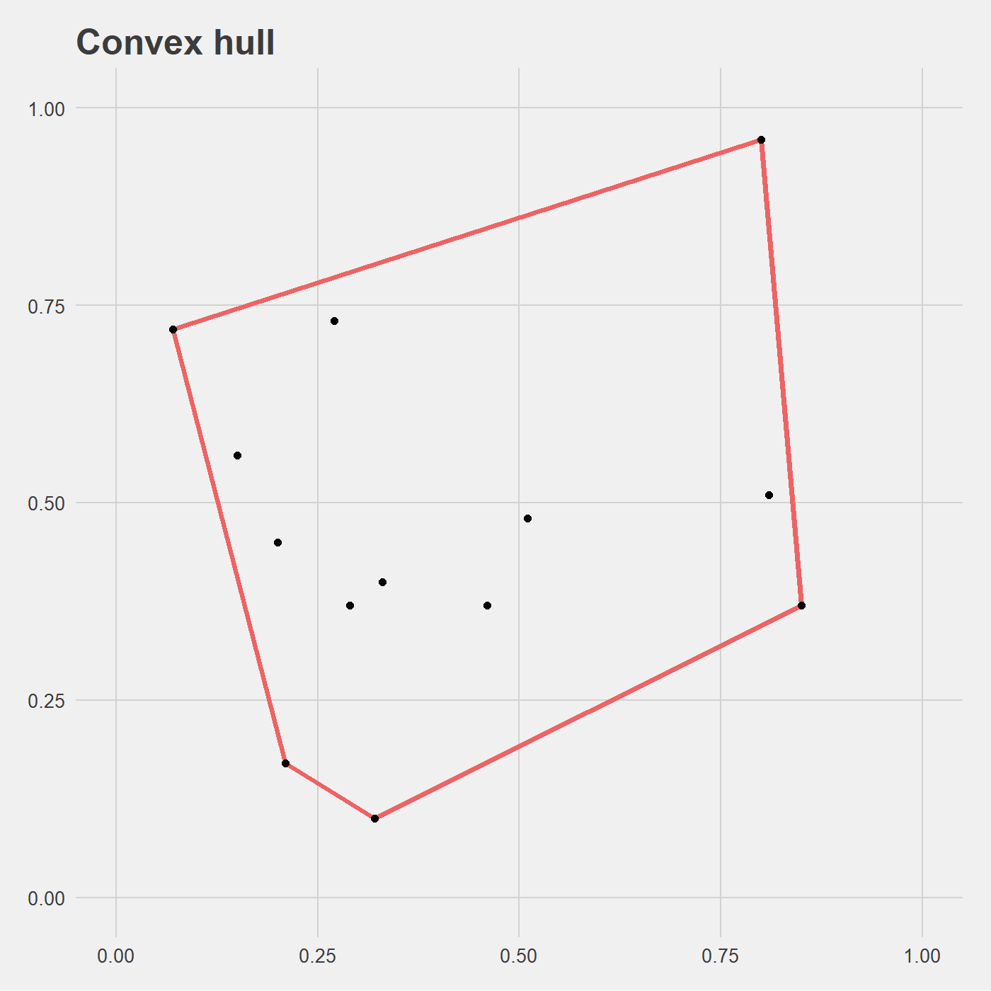
Focus on unweighted case (RCH)

Slide 22
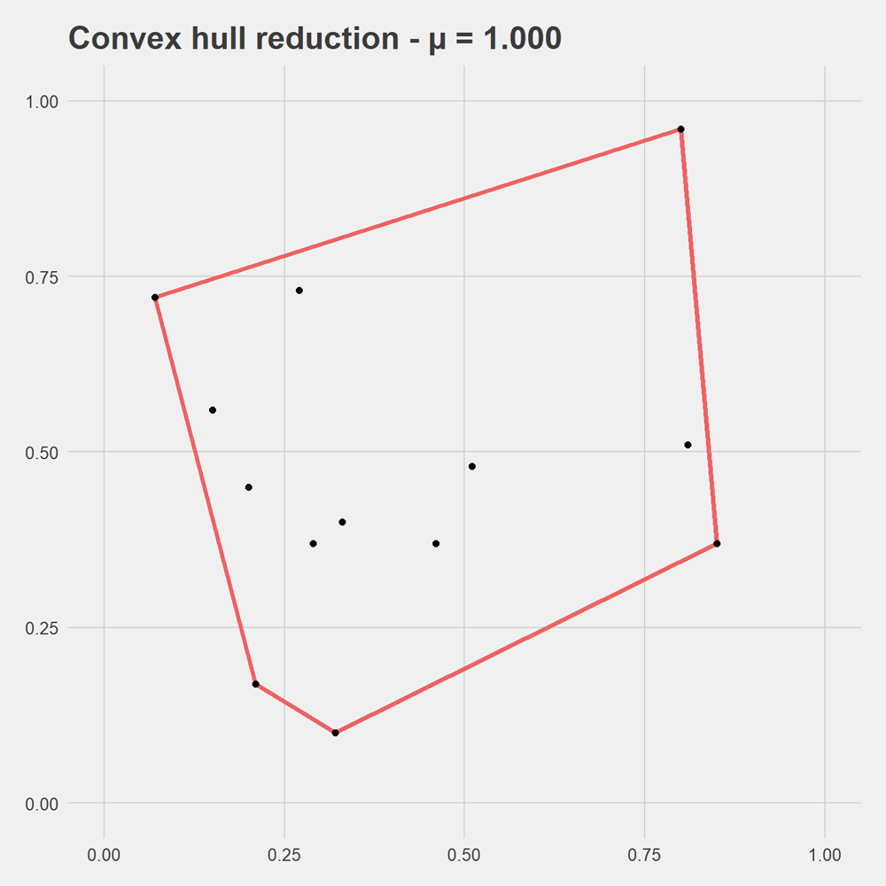
Focus on unweighted case (RCH)

Slide 23
Now reduce our overlapping convex hulls

Slide 24
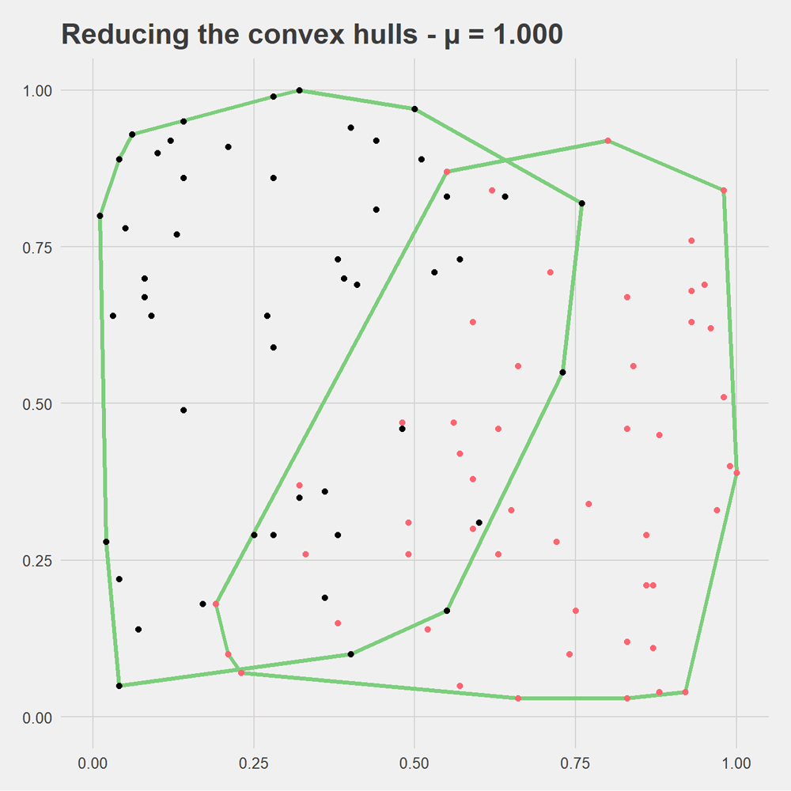
Now reduce our overlapping convex hulls

Slide 25
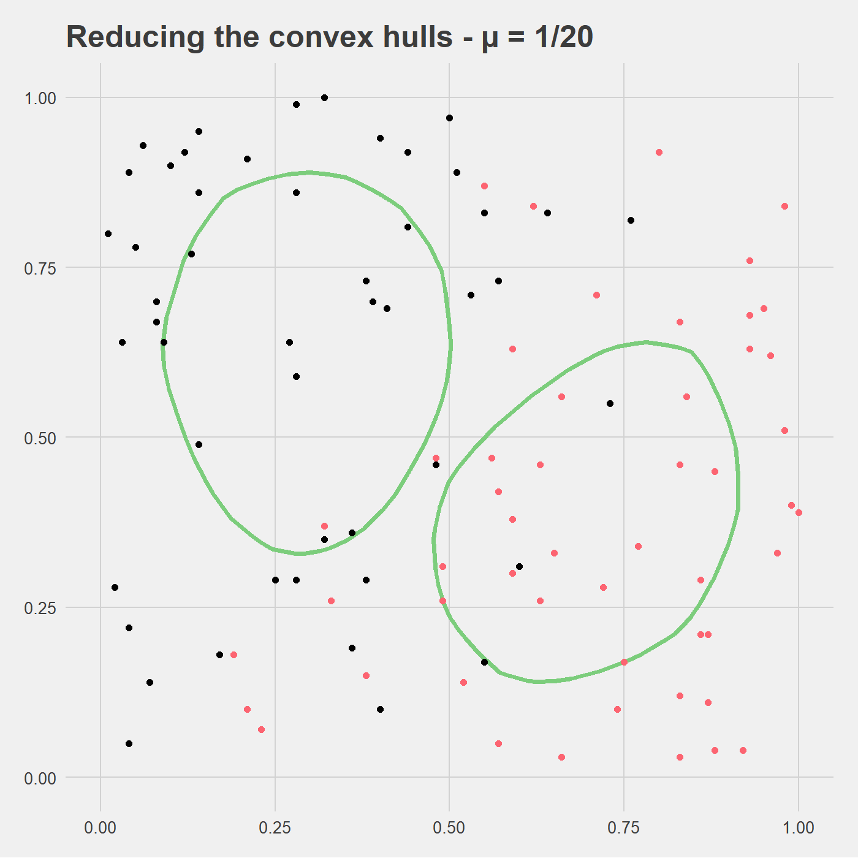
Now reduce our overlapping convex hulls

Slide 26
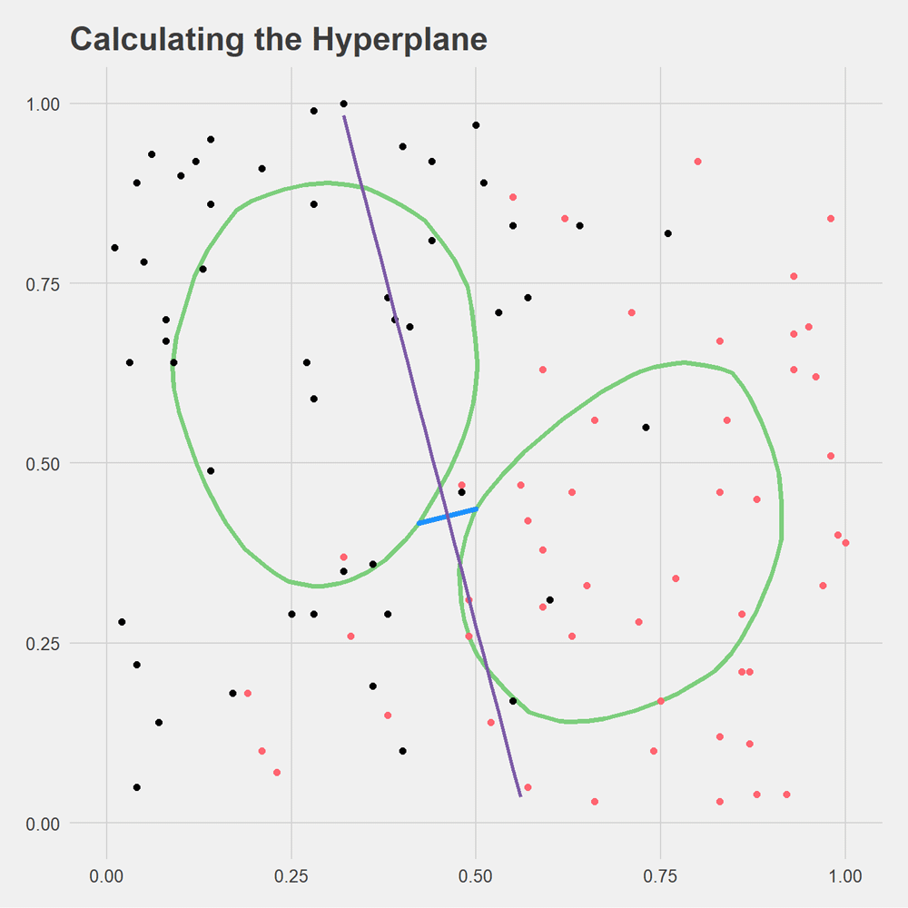
Now run the algorithm

Slide 27
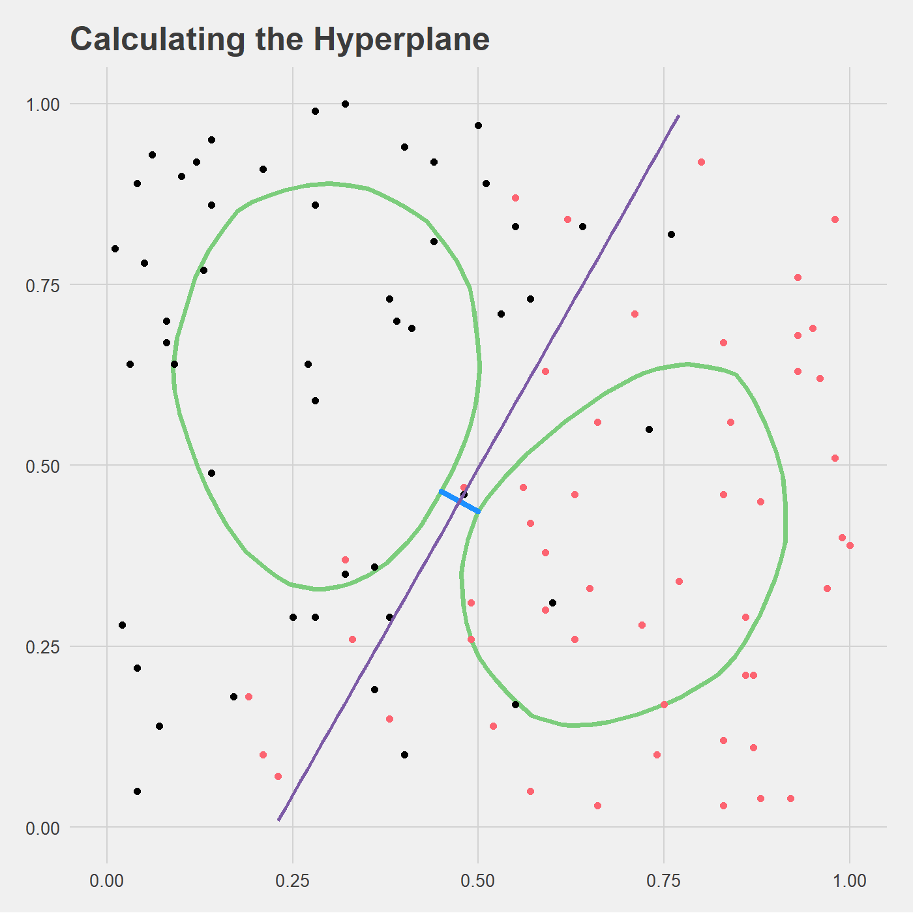
Now run the algorithm

Slide 28
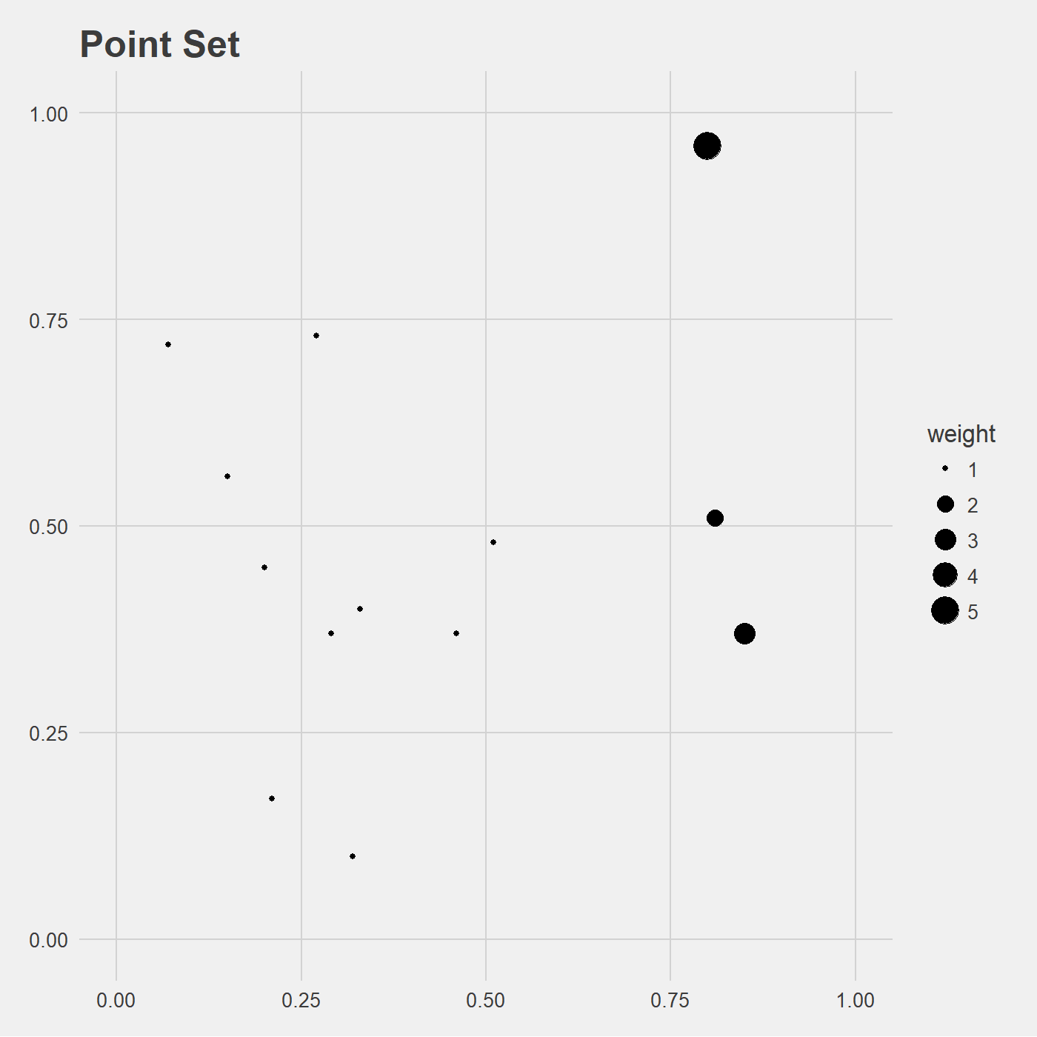
Weighted case (WRCH)

Slide 29
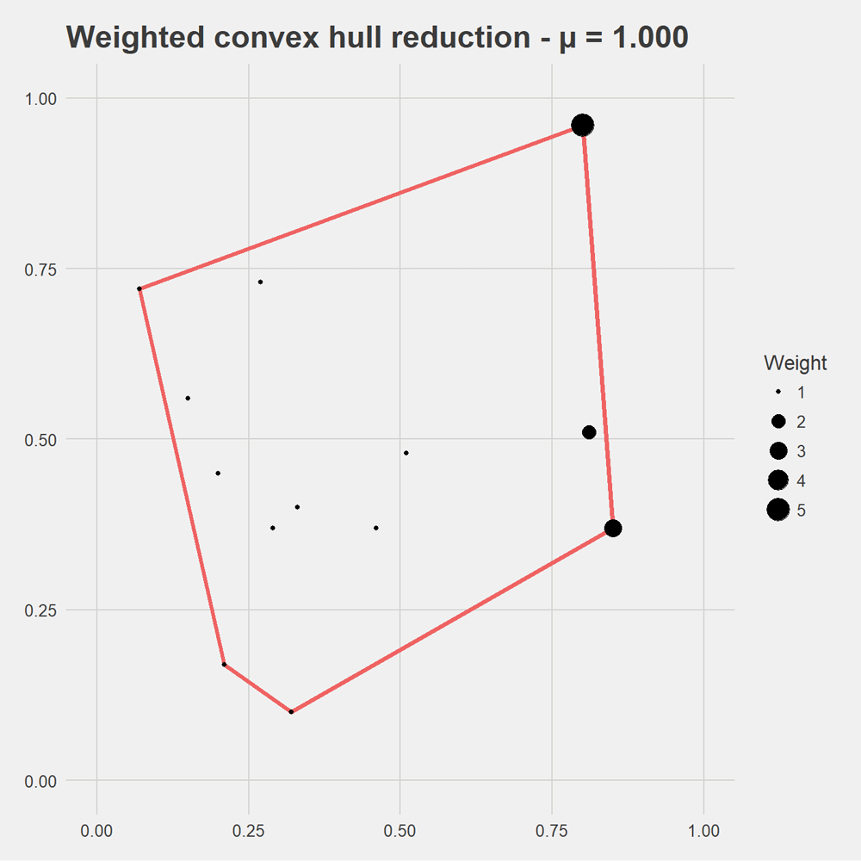
Weighted case (WRCH)

Slide 30
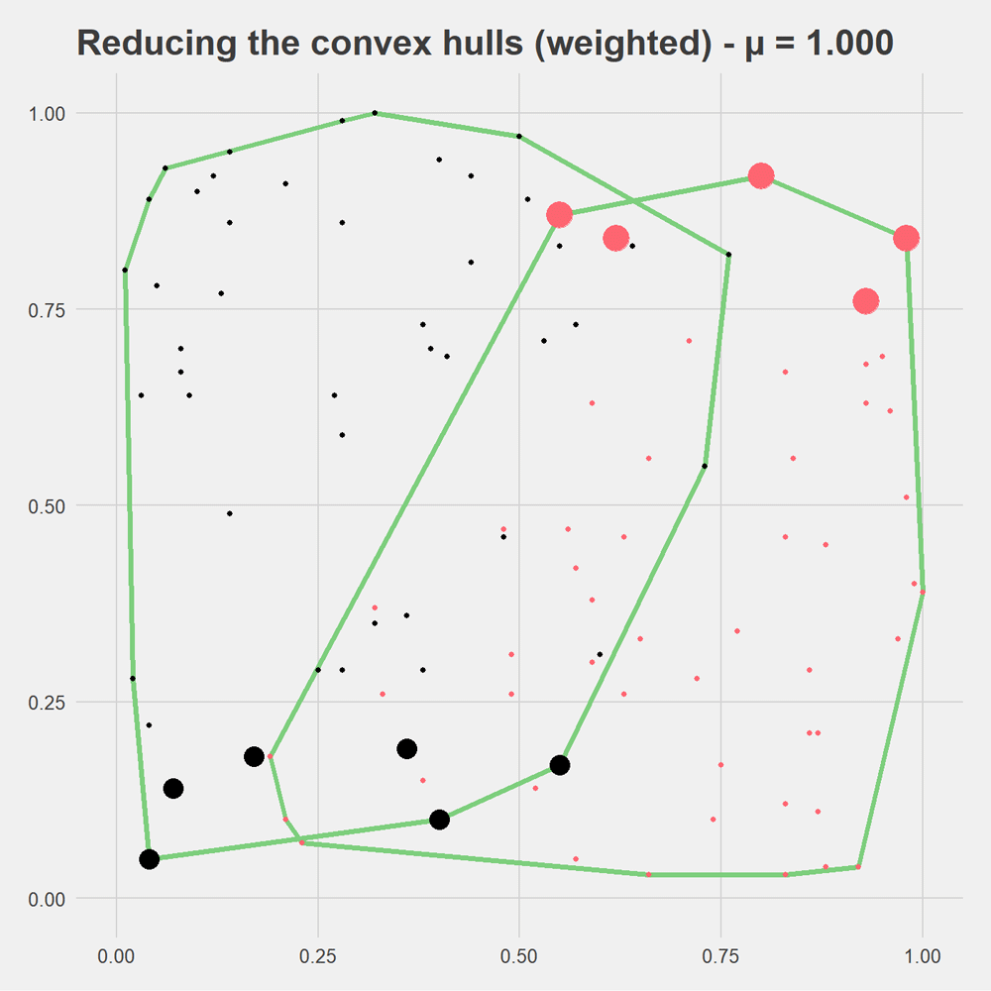
Reduce our overlapping CHs (weighted)

Slide 31
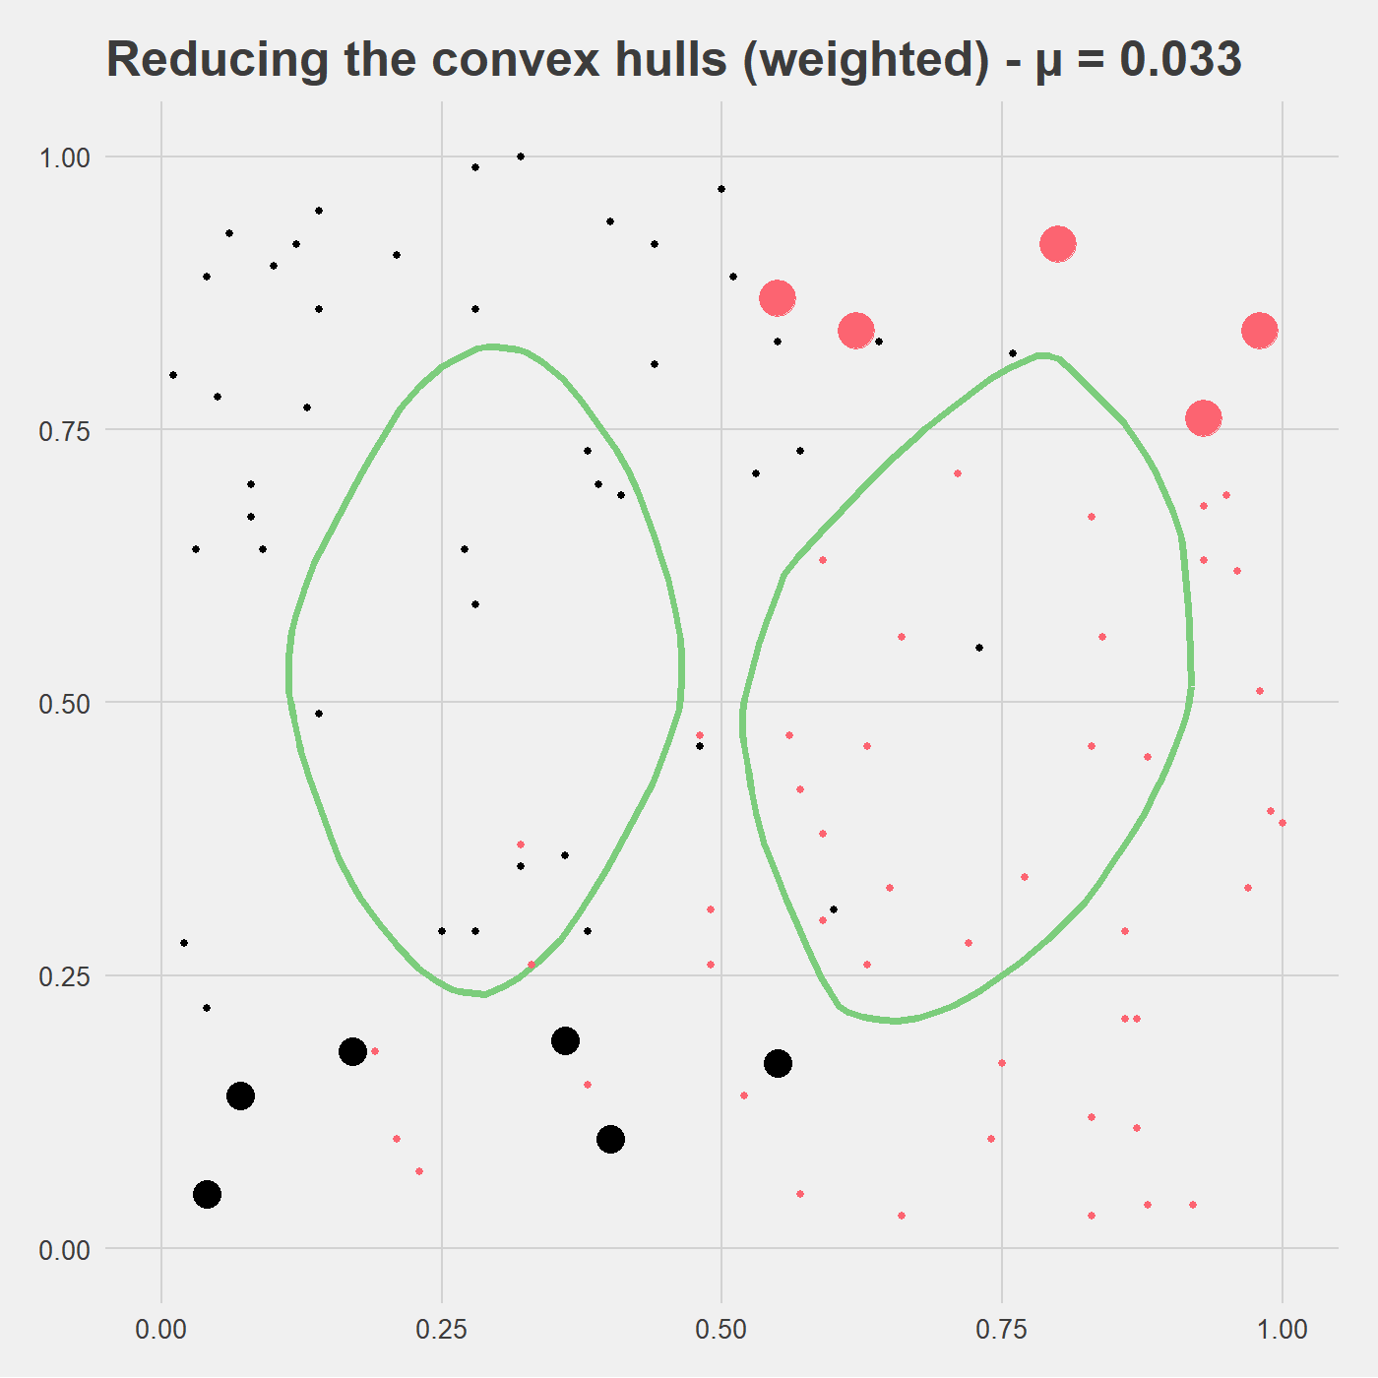
Reduce our overlapping CHs (weighted)

Slide 32
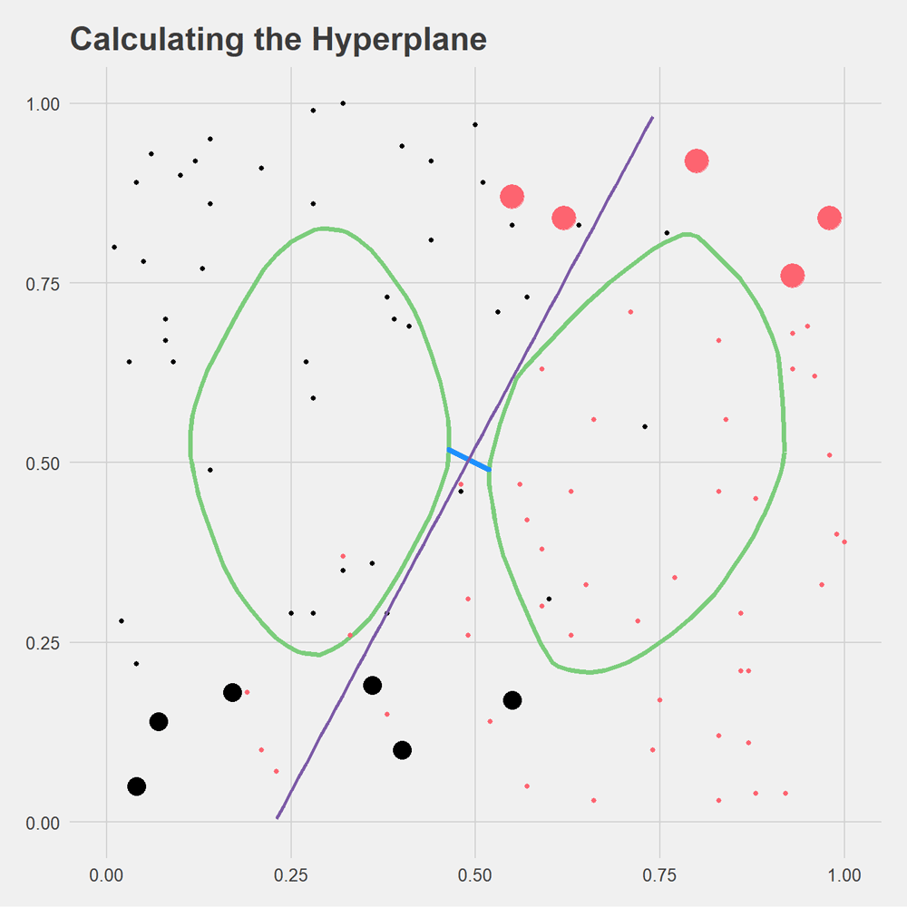
Run the WRCH SVM

Slide 33
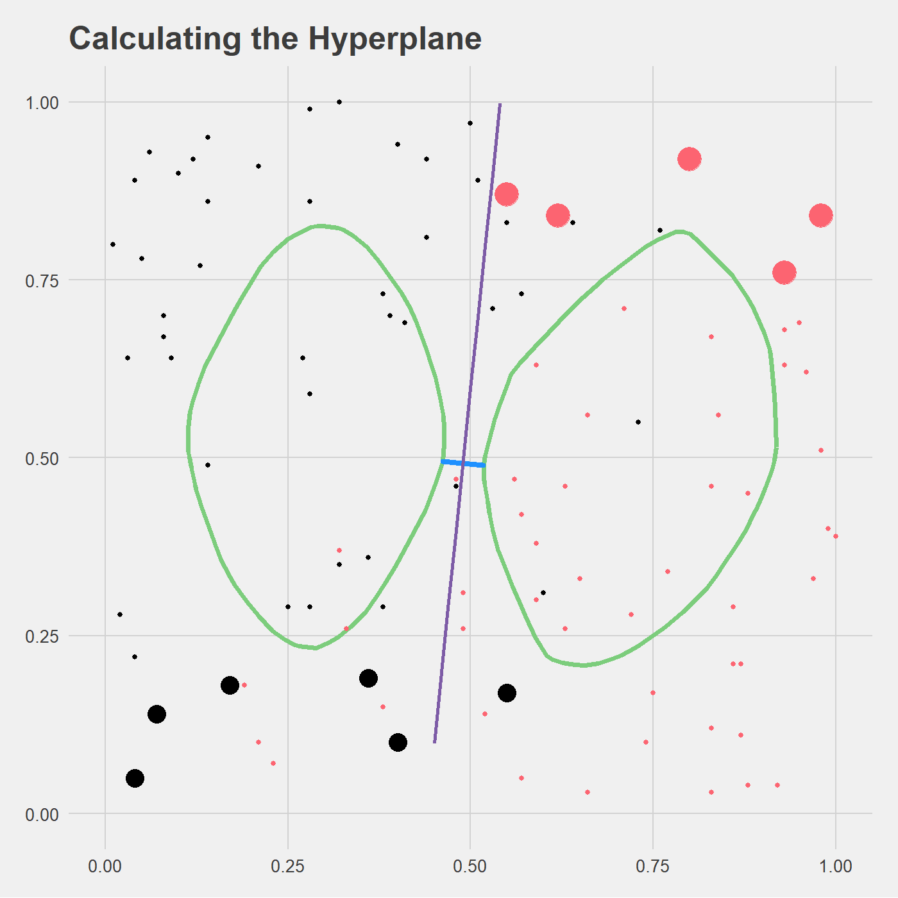
Run the WRCH SVM
$$w⋅x+b<0$$
$$w⋅x+b=0$$
$$w⋅x+b>0$$
Hyperplane is the perpendicular bisector of w

Slide 34
What about multiple classes?
Petal.Length | Petal.Width
1.4 | 0.2
1.4 | 0.2
1.3 | 0.2
4.7 | 1.4
4.5 | 1.5
4.9 | 1.5
6 | 2.5
5.1 | 1.9
5.9 | 2.1
Species | Species 1
 | Species 2
 | Species 3
ℝ²

Slide 35
Pair them up and vote!
A
B
C
train(A,B)
predictor_{(A,B)}
train(A,C)
predictor_{(A,C)}
train(B,C)
predictor_{(B,C)}

Slide 36
Pair them up and vote!
predictor_{(A,B)}
B
predictor_{(A,C)}
C
New Data Point
predictor_{(B,C)}
C

Slide 37
What if there’s a tie? Runoff voting!
predictor_{(A,B)}
A
predictor_{(A,C)}
A
predictor_{(A,D)}
D
New point
predictor_{(B,C)}
B
predictor_{(B,D)}
B
predictor_{(C,D)}
C

Slide 38
What if there’s a tie? Runoff voting!
predictor_{(A,B)}
A
predictor_{(A,C)}
A
predictor_{(A,D)}
D
A or B
New point
predictor_{(B,C)}
B
predictor_{(B,D)}
B
predictor_{(C,D)}
C

Slide 39
Infinitely looping runoff?
predictor_{(A,B)}
A
predictor_{(A,C)}
A
predictor_{(A,D)}
D
Pick randomly
New point
predictor_{(B,C)}
B
predictor_{(B,D)}
B
predictor_{(C,D)}
D

Slide 40
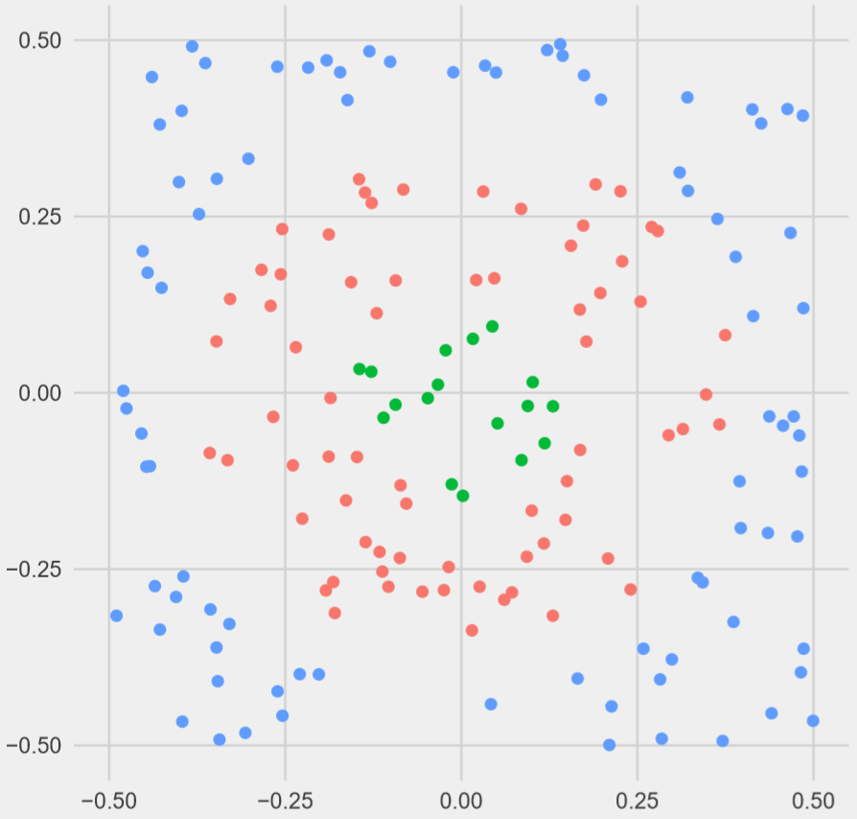
Non-linearly separable case?
??

Slide 41
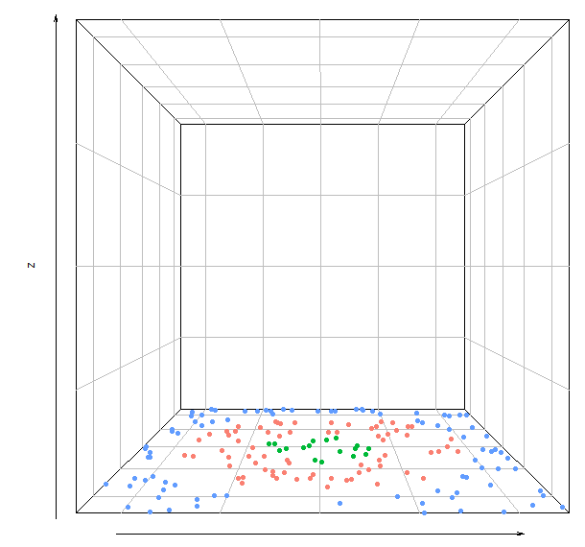
Project onto parabaloid

Slide 42
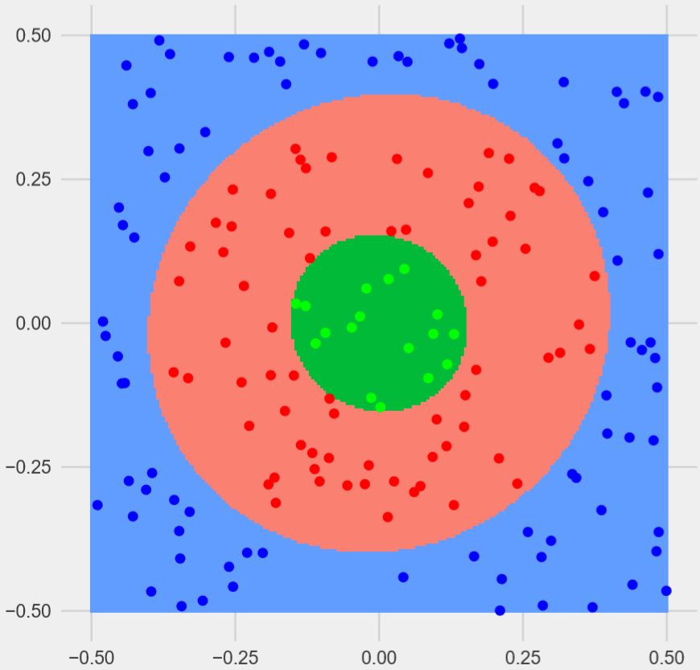

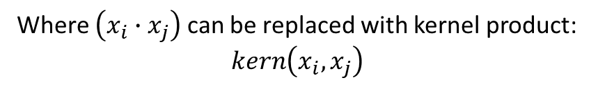
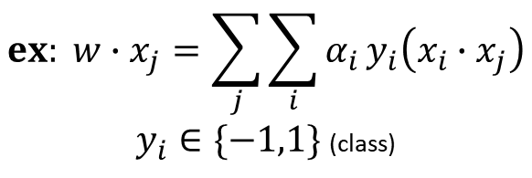
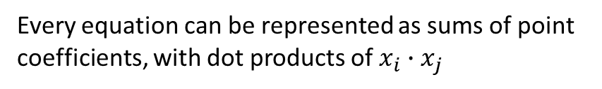
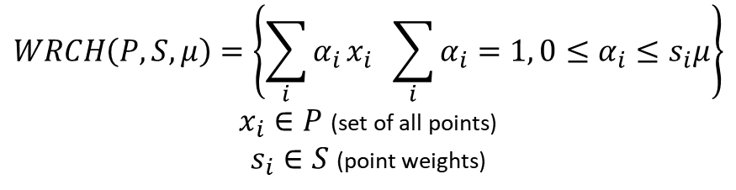
Monomial kernel decision surface
$$WRCH\left(P,S,μ\right)=\left\{\sum_{i}{α_{i}}x_{i} \sum_{i}{α_{i}}=1, 0≤α_{i}≤s_{i}μ\right\}$$
$x_{i}∈P$ (set of all points)
$s_{i}∈S$ (point weights)
Every equation can be represented as sums of point coefficients, with dot products of $x_{i}∙x_{j}$
$$ex: w∙x_{j}=\sum_{j}{\sum_{i}{α_{i}}y_{i}\left(x_{i}∙x_{j}\right)}$$
$y_{i}∈\{−1,1\}$ (class)
Where $\left(x_{i}∙x_{j}\right)$ can be replaced with kernel product: $kern\left(x_{i},x_{j}\right)$
$$Monomial kernel={(x_{i}∙x_{j})}^{2}$$

Slide 43
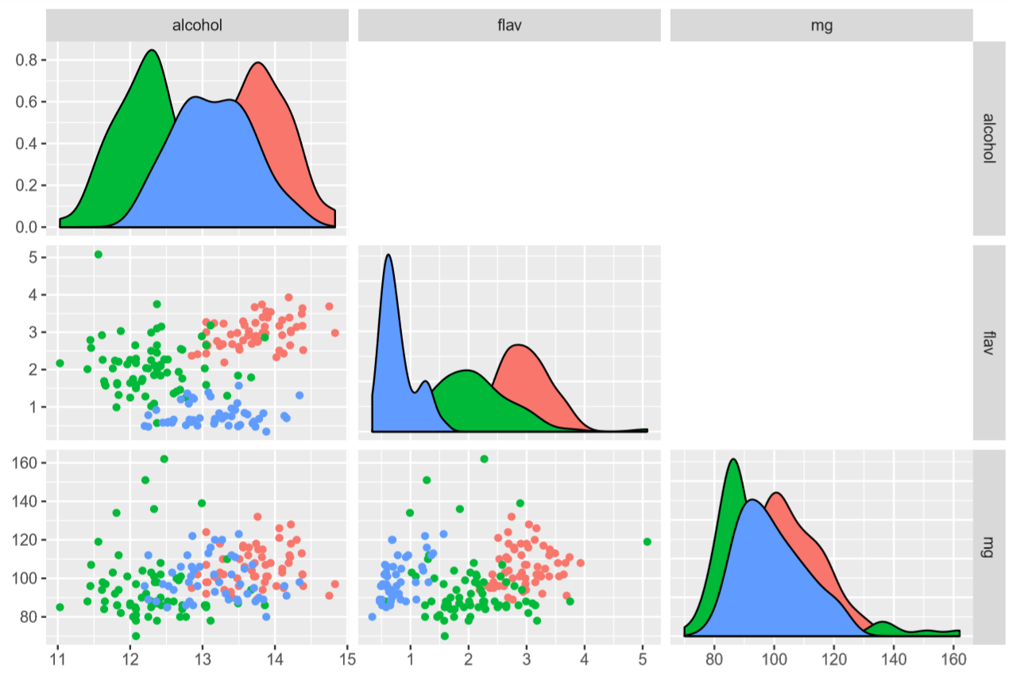
So it works in 2D on fake data, how about 3D?
Wine 1
Wine 2
Wine 3

Slide 44
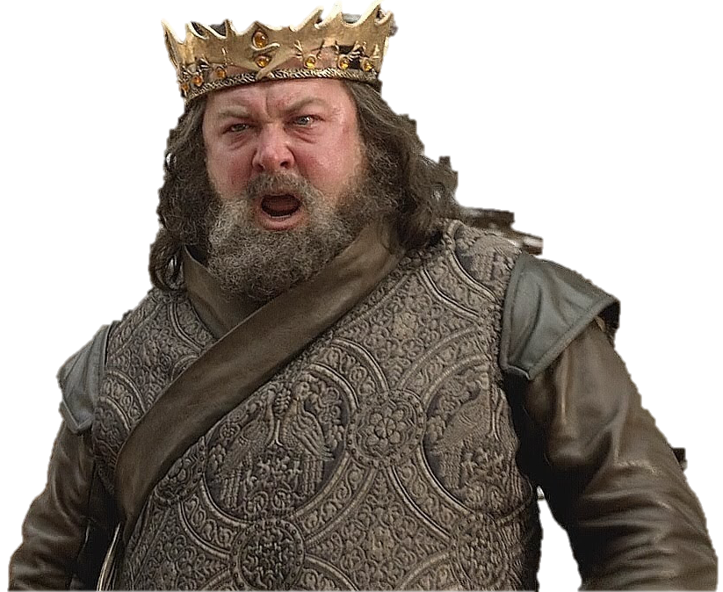
Results
MORE WINE!
Ran with all weights equal, gaussian kernel
 |  | Reference
 |  | Wine 1 | Wine 2 | Wine 3
Predicted | Wine 1 | 55 | 3 | 0
 | Wine 2 | 3 | 65 | 1
 | Wine 3 | 0 | 3 | 47
94.4% accuracy

Slide 45
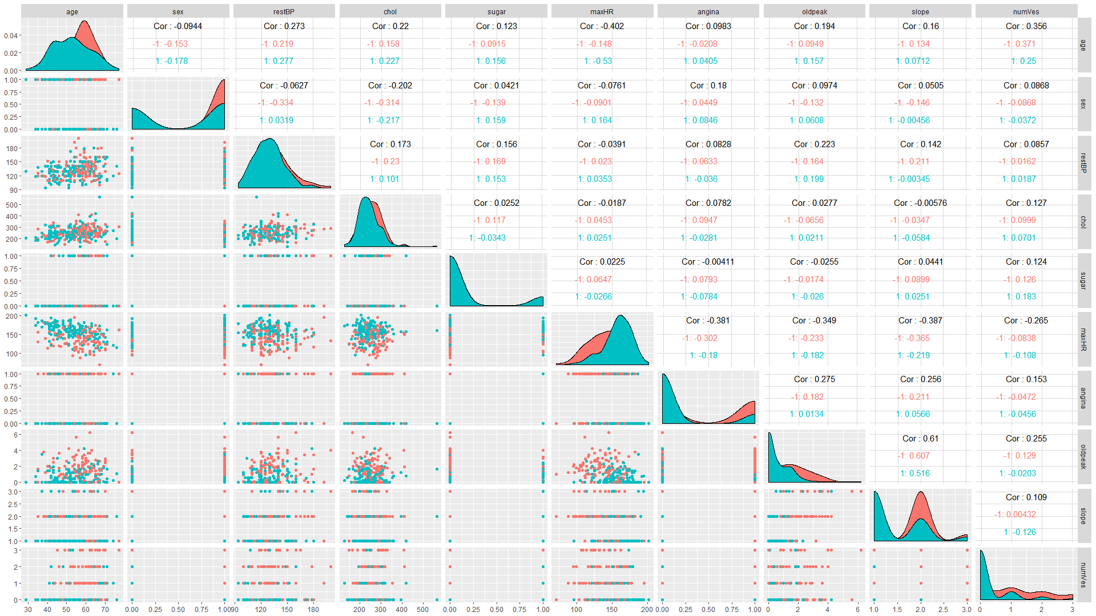
Let’s predict heart disease
Heart disease
Absence
Presence

Slide 46
Results
Weigh presence class 5x more than absence class
Ran with all weights equal
 |  | Reference
 |  | Absence | Presence
Predicted | Absence | 125 | 36
 | Presence | 25 | 84
 |  | Reference
 |  | Absence | Presence
Predicted | Absence | 100 | 8
 | Presence | 50 | 112
77.4% accuracy
Lots of false negatives! (13%)
78.5% accuracy
Far fewer false negatives! (3%)

Slide 47
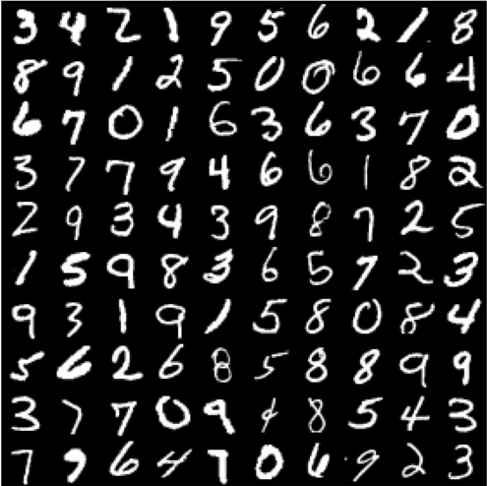
Optical Character Recognition (OCR)
[0-255] [0-255] [0-255] [0-255] [0-255] [0-255]
[0-255] [0-255] [0-255] [0-255] [0-255] [0-255]
[0-255] [0-255] [0-255] [0-255] [0-255] [0-255]
[0-255] [0-255] [0-255] [0-255] [0-255] [0-255]
[0-255] [0-255] [0-255] [0-255] [0-255] [0-255]
[0-255] [0-255] [0-255] [0-255] [0-255] [0-255]
[0-255] [0-255] [0-255] [0-255] [0-255] [0-255]
[0-255] [0-255] [0-255] [0-255] [0-255] [0-255]
[0-255] [0-255] [0-255] [0-255] [0-255] [0-255]
[0-255] [0-255] [0-255] [0-255] [0-255] [0-255]
[0-255] [0-255] [0-255] [0-255] [0-255] [0-255]
[0-255] [0-255] [0-255] [0-255] [0-255] [0-255]
[0-255] [0-255] [0-255] [0-255] [0-255] [0-255]
MNIST DATABASE

Slide 48
Optical Character Recognition (OCR)
[0-255] [0-255] [0-255] [0-255] [0-255] [0-255]
[0-255] [0-255] [0-255] [0-255] [0-255] [0-255]
[0-255] [0-255] [0-255] [0-255] [0-255] [0-255]
[0-255] [0-255] [0-255] [0-255] [0-255] [0-255]
[0-255] [0-255] [0-255] [0-255] [0-255] [0-255]
[0-255] [0-255] [0-255] [0-255] [0-255] [0-255]
[0-255] [0-255] [0-255] [0-255] [0-255] [0-255]
[0-255] [0-255] [0-255] [0-255] [0-255] [0-255]
[0-255] [0-255] [0-255] [0-255] [0-255] [0-255]
[0-255] [0-255] [0-255] [0-255] [0-255] [0-255]
[0-255] [0-255] [0-255] [0-255] [0-255] [0-255]
[0-255] [0-255] [0-255] [0-255] [0-255] [0-255]
[0-255] [0-255] [0-255] [0-255] [0-255] [0-255]
 | Pixel Number
# | 1 | 2 | 3 | 4 | 5 | 6 | 7 | 8 | 9 | 10
1 | 0 | 0 | 0 | 0 | 0 | 0 | 0 | 0 | 0 | 0 | …
6 | 0 | 0 | 0 | 0 | 0 | 0 | 0 | 0 | 0 | 0 | …
8 | 0 | 0 | 0 | 0 | 0 | 0 | 0 | 0 | 0 | 0 | …
1 | 0 | 0 | 0 | 0 | 0 | 0 | 0 | 0 | 0 | 0 | …
7 | 0 | 0 | 0 | 0 | 0 | 0 | 0 | 0 | 0 | 0 | …
9 | 0 | 0 | 0 | 0 | 0 | 0 | 0 | 0 | 0 | 0 | …
94% accuracy
Only used 3% of data to train

Slide 49
My Implementation
Data
R
Java
Super slow
Super fast
Predictor object
Notes:
Implemented in parallel in Java, each SVM runs on its own thread.
Binary classification: 50x faster in Java, without multithreading

Slide 50
It’s an R Package! (almost)
Installation
require(devtools)
install_github(“mhmdmodan/JSUpySVM”)
Usage
predictor <- WSVM(data, kernel)
predictor$predict(vector)

Slide 51
Future
Finish R front end
create docs
publish to CRAN
Implement optimal parameter search
Currently:
μ = 1/(0.9k) where k = sum of the weights in the smallest (by weight) class

Slide 52
Works Cited
[1] M. E. Mavroforakis and S. Theodoridis, “A geometric approach to Support Vector Machine (SVM) classification,” IEEE Transactions on Neural Networks, vol. 17, no. 3, pp. 671–682, May 2006.
[2] V. Franc and V. Hlaváč, “An iterative algorithm learning the maximal margin classifier,” Pattern Recognition, vol. 36, no. 9, pp. 1985–1996, Sep. 2003.
[3] S. Theodoridis and M. Mavroforakis, “Reduced Convex Hulls: A Geometric Approach to Support Vector Machines [Lecture Notes],” IEEE Signal Processing Magazine, vol. 24, no. 3, pp. 119–122, May 2007.
[4] B. Goodrich, D. Albrecht, and P. Tischer, “Training weighted SVMs using a generalized Schlesinger-Kozinec algorithm,” 2011, pp. 2435–2440.

